Slide 1
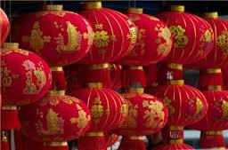
Chinese New Year 2016

Slide 2
When
Chinese New Year always falls on the first day of January of the Lunar calendar, which is based on cycles of moon phases. Because there are more than 12 moon cycles, the first day of January of the Lunar calendar is different from year to year.

Slide 3
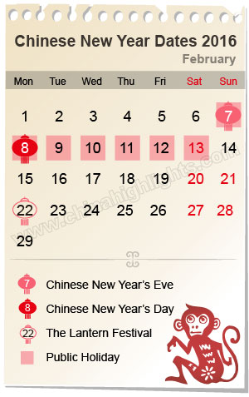

From this calendar, guess when is Chinese New Year?
Guess how long Chinese New Year last?
8
You guessed it!
It is Monkey !
Do you know 2016 is the year of (which animal)?

Slide 4
Where
Do you know Chinese New Year is also observed and celebrated outside of China?
to name a few …
Indonesia
Malaysia
North and South Korea
Singapore
and Vietnam

Slide 5
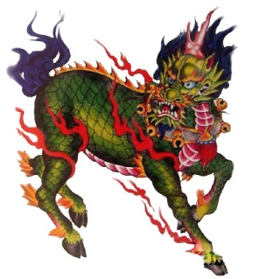
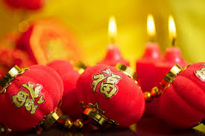
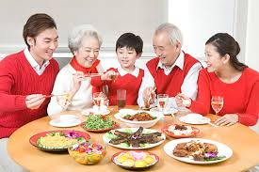
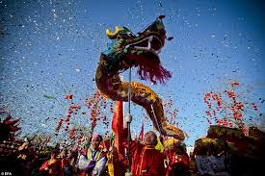
Why
Chinese New Year celebration was born out of fear and myth.
Today, Chinese New Year is one of most important holiday. It is a time for families near and far to be together to celebrate traditions.
Notes:
Chinese New Year legend – wild beast Nien appears at the end of each year attacking villagers.
Most important meal of the celebration is believed to be the New Year’s Eve dinner where families gather around the table with a big feast.

Slide 6
How
Traditions
Greetings
Food
Clothing
Festive activities
Thanks to the boys and girls of NES, they worked very hard to present the many activities celebrated during the Chinese New Year.
Names here……….

