Slide 1
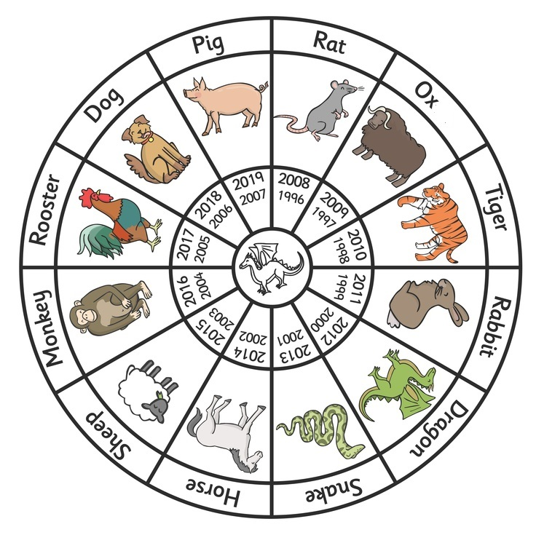
猪
鼠
狗
牛
My name is
__________________
My birthday is
______________________
I was born in the Year of
______
鸡
虎
猴
兔
羊
龙
马
蛇

